Slide 1
Amy Hale BSN, RN
A True Story Of Surviving Domestic Abuse

Slide 2
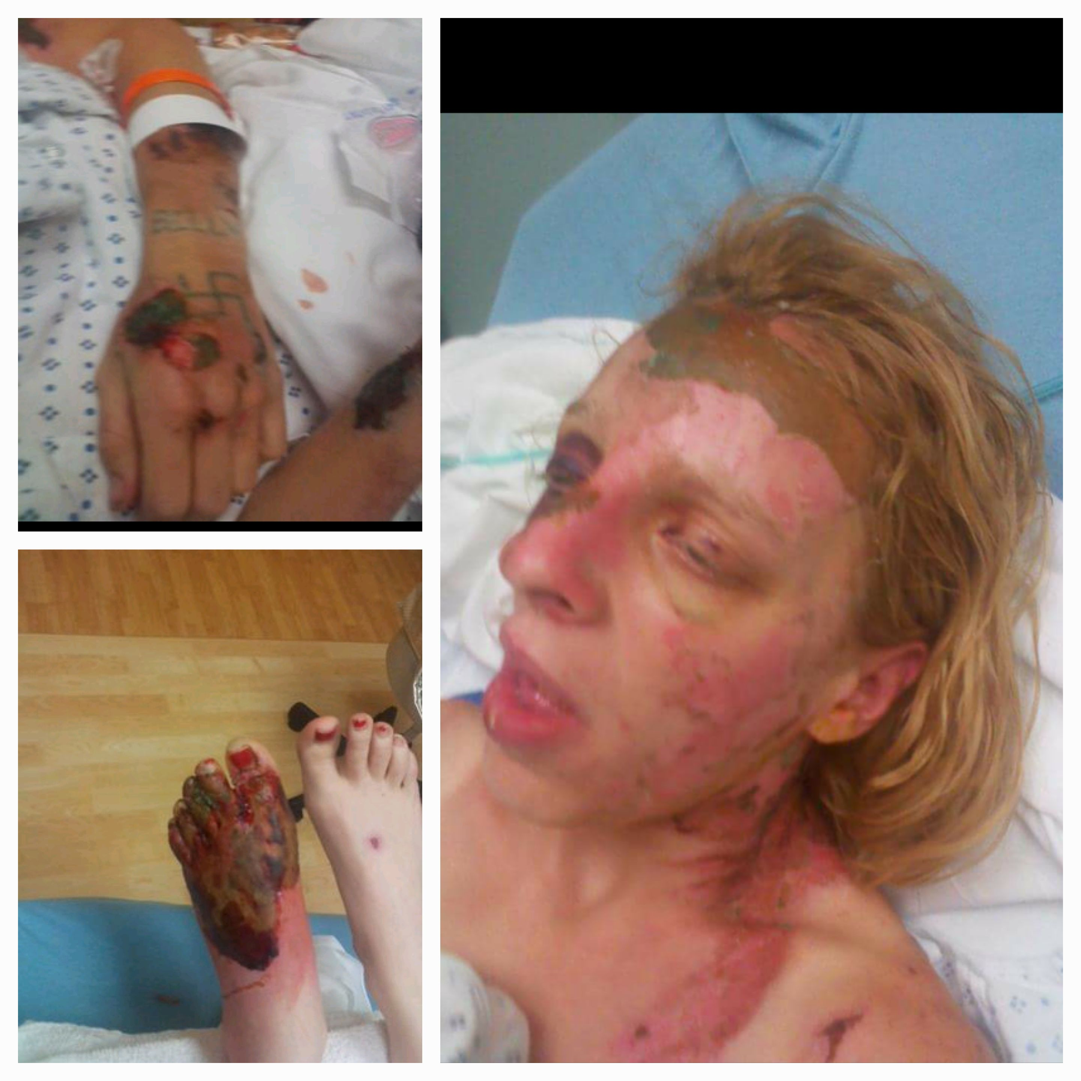
April 18, 2011

Slide 3
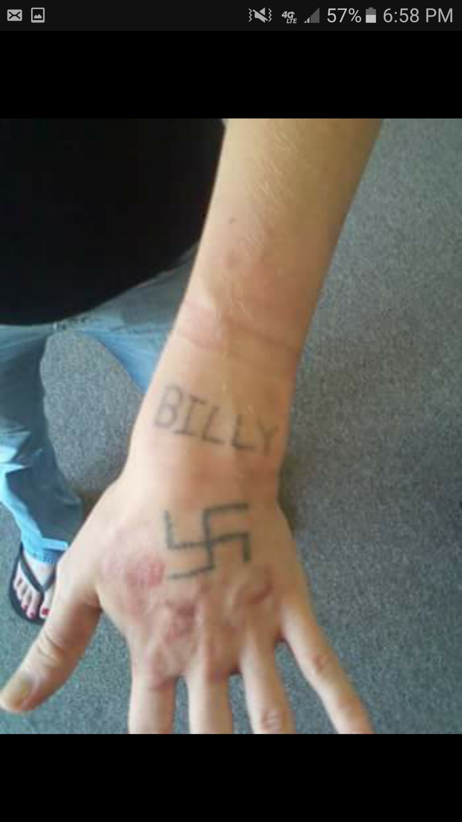
Tattoo Removal Treatments

Slide 4
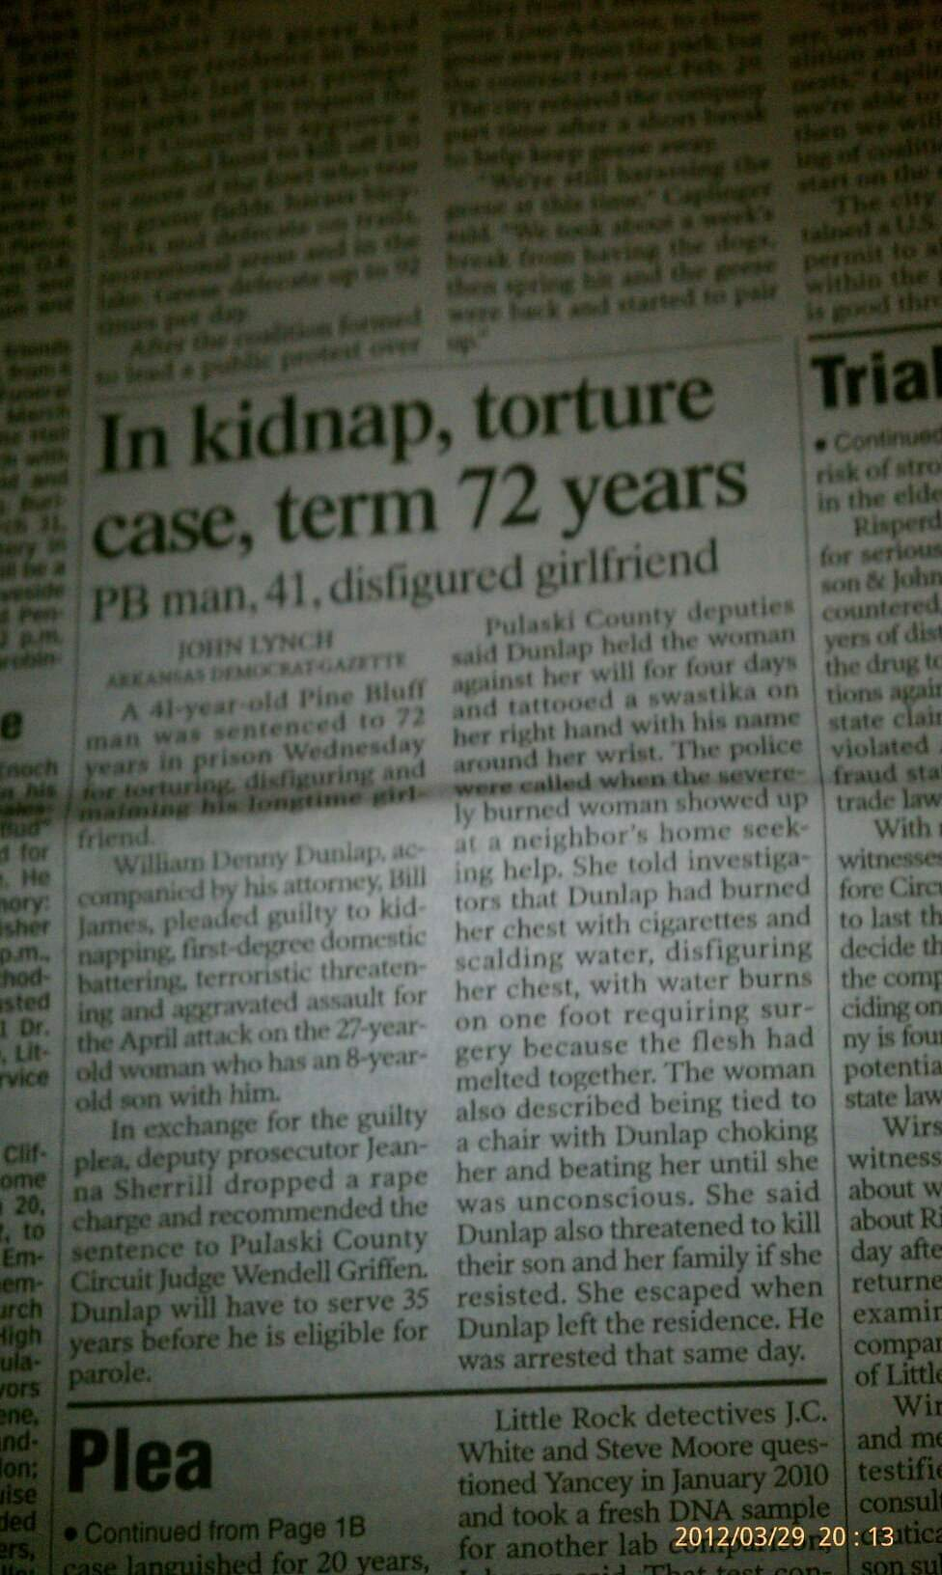
Newspaper Article About Arrest

Slide 5
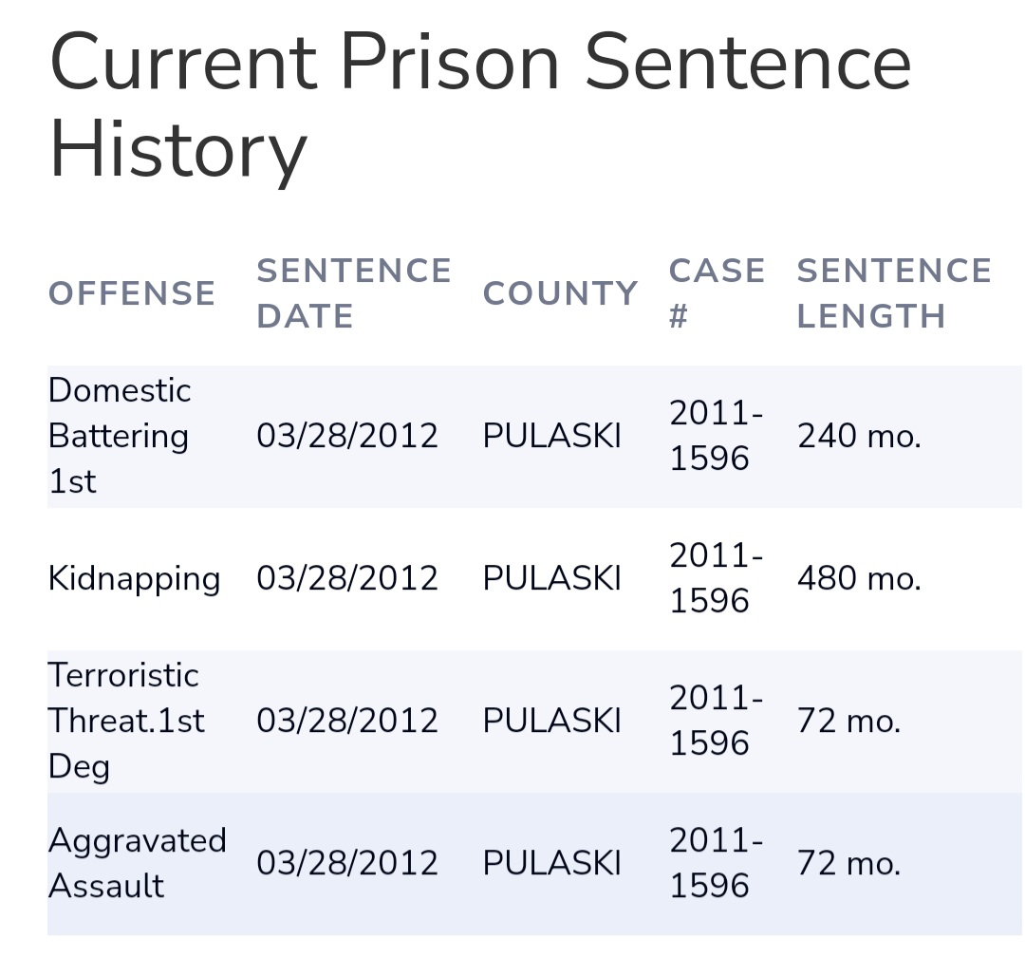
Was This Justice???

Slide 6
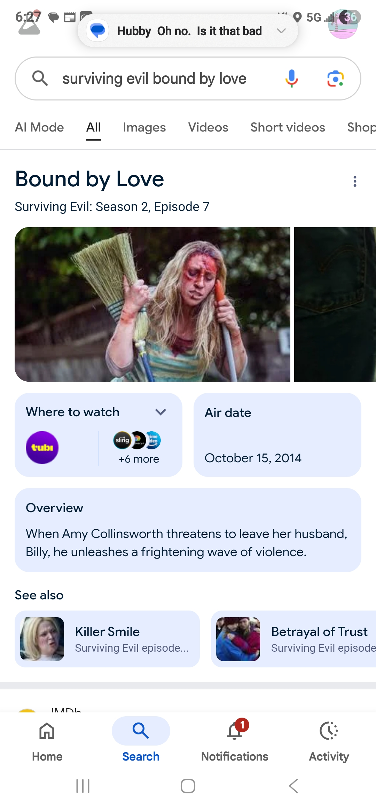
Reenactment of the Horrifying Events

Slide 7

Practical Nursing Graduation

Slide 8
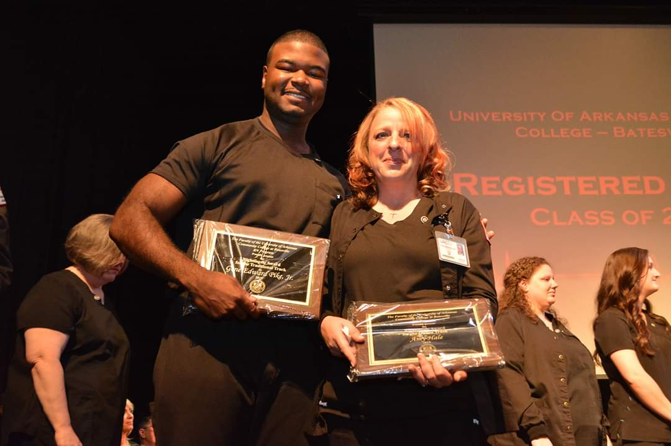
RN Graduation-Florence Nightingale Award

Slide 9
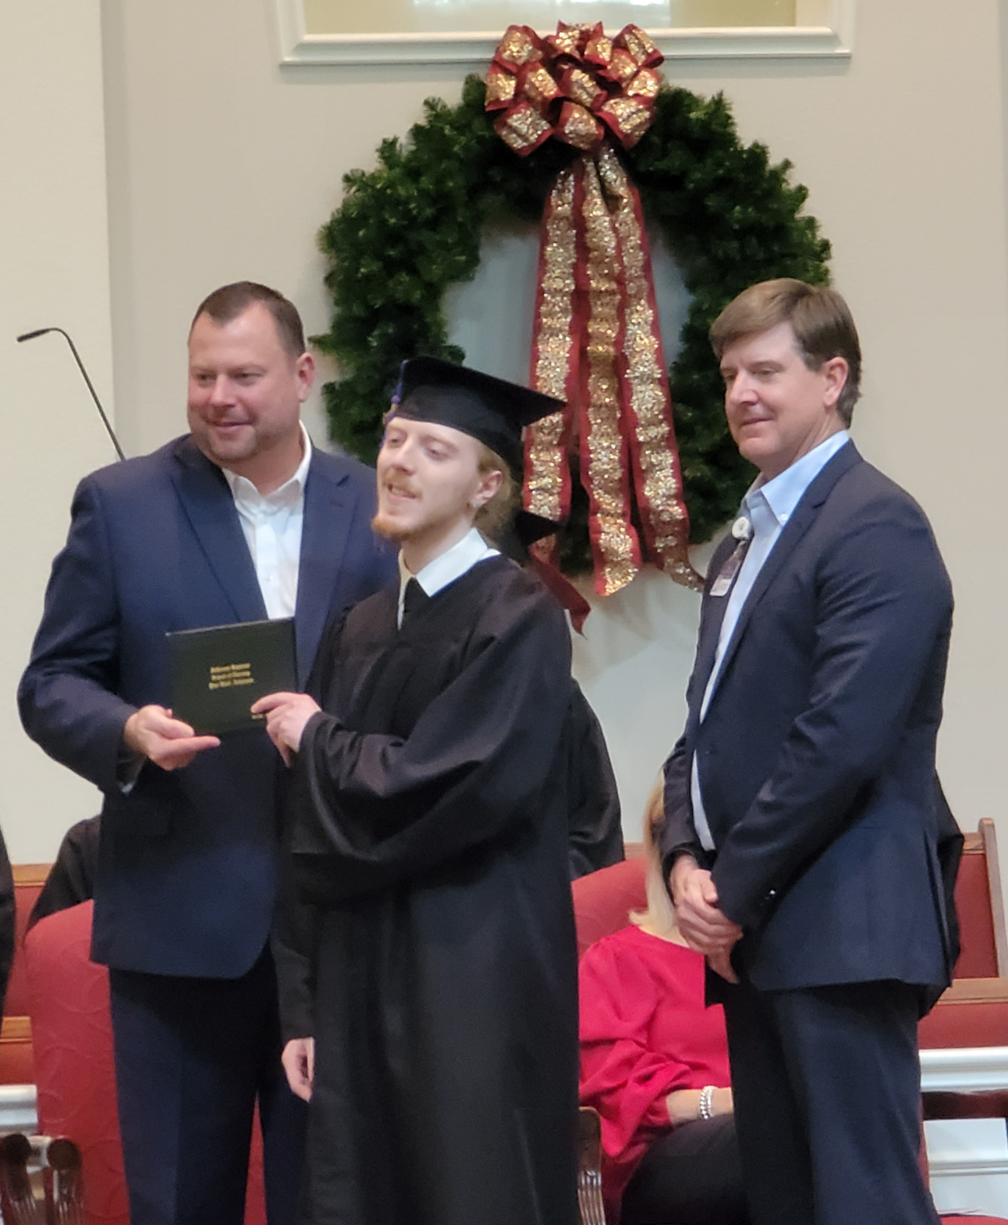
My Son’s RN Graduation-Defying Odds

Slide 10
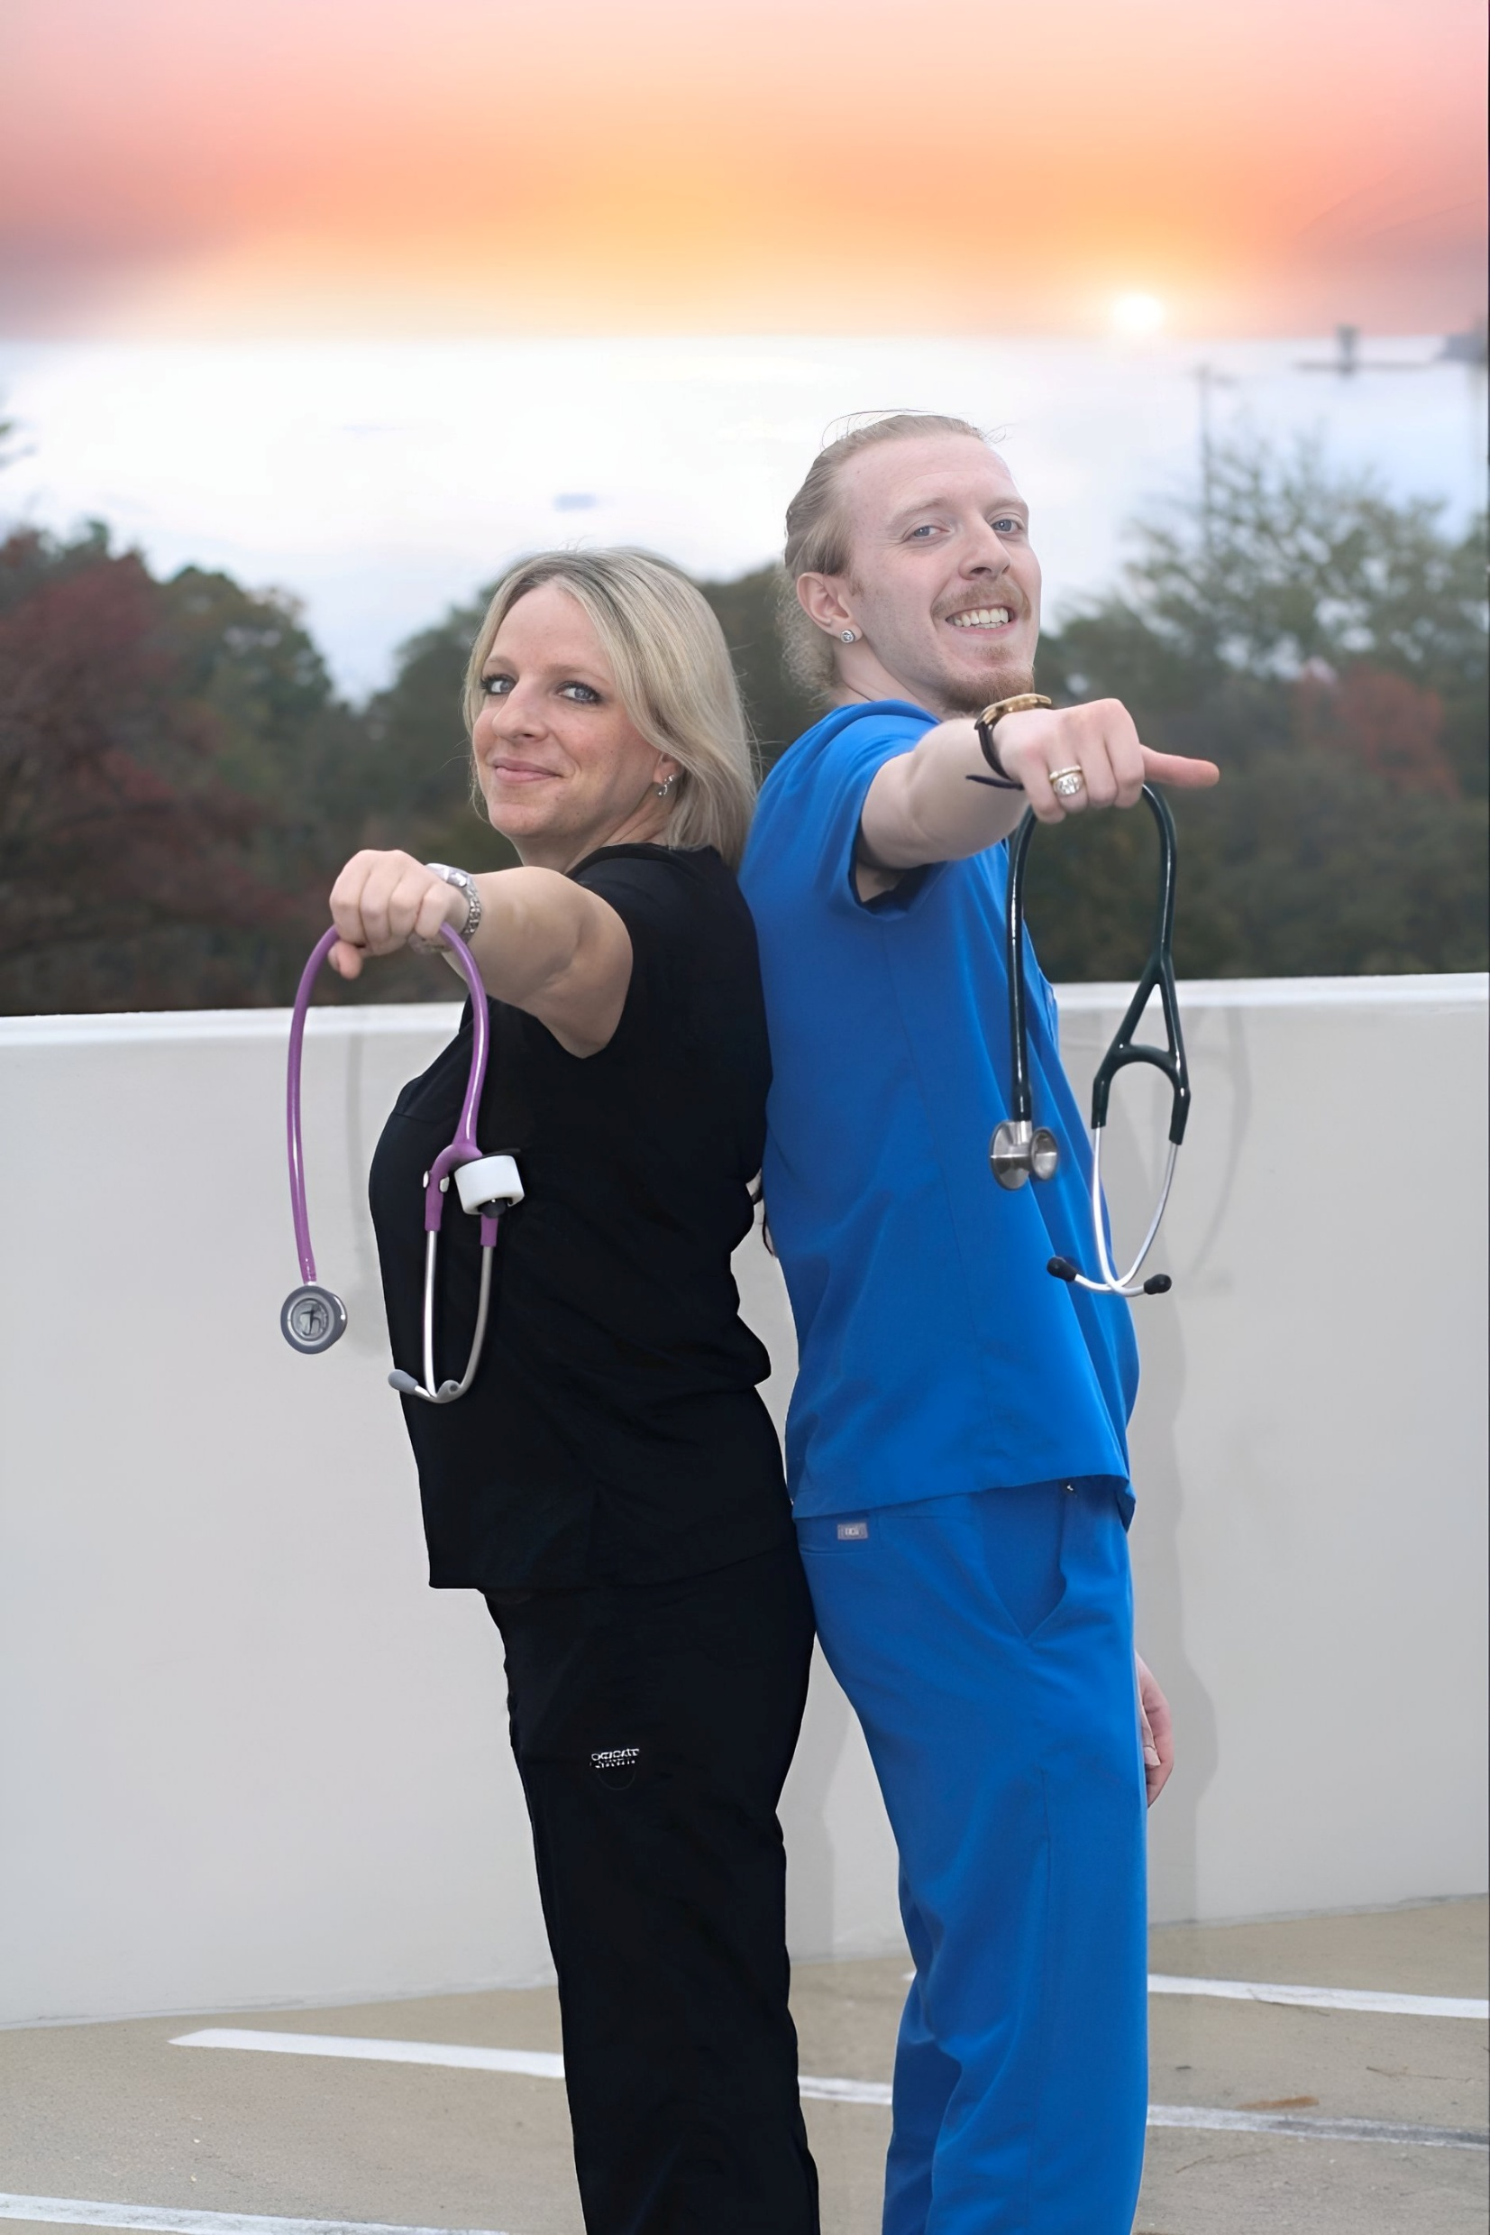
Overcoming Together

Slide 11
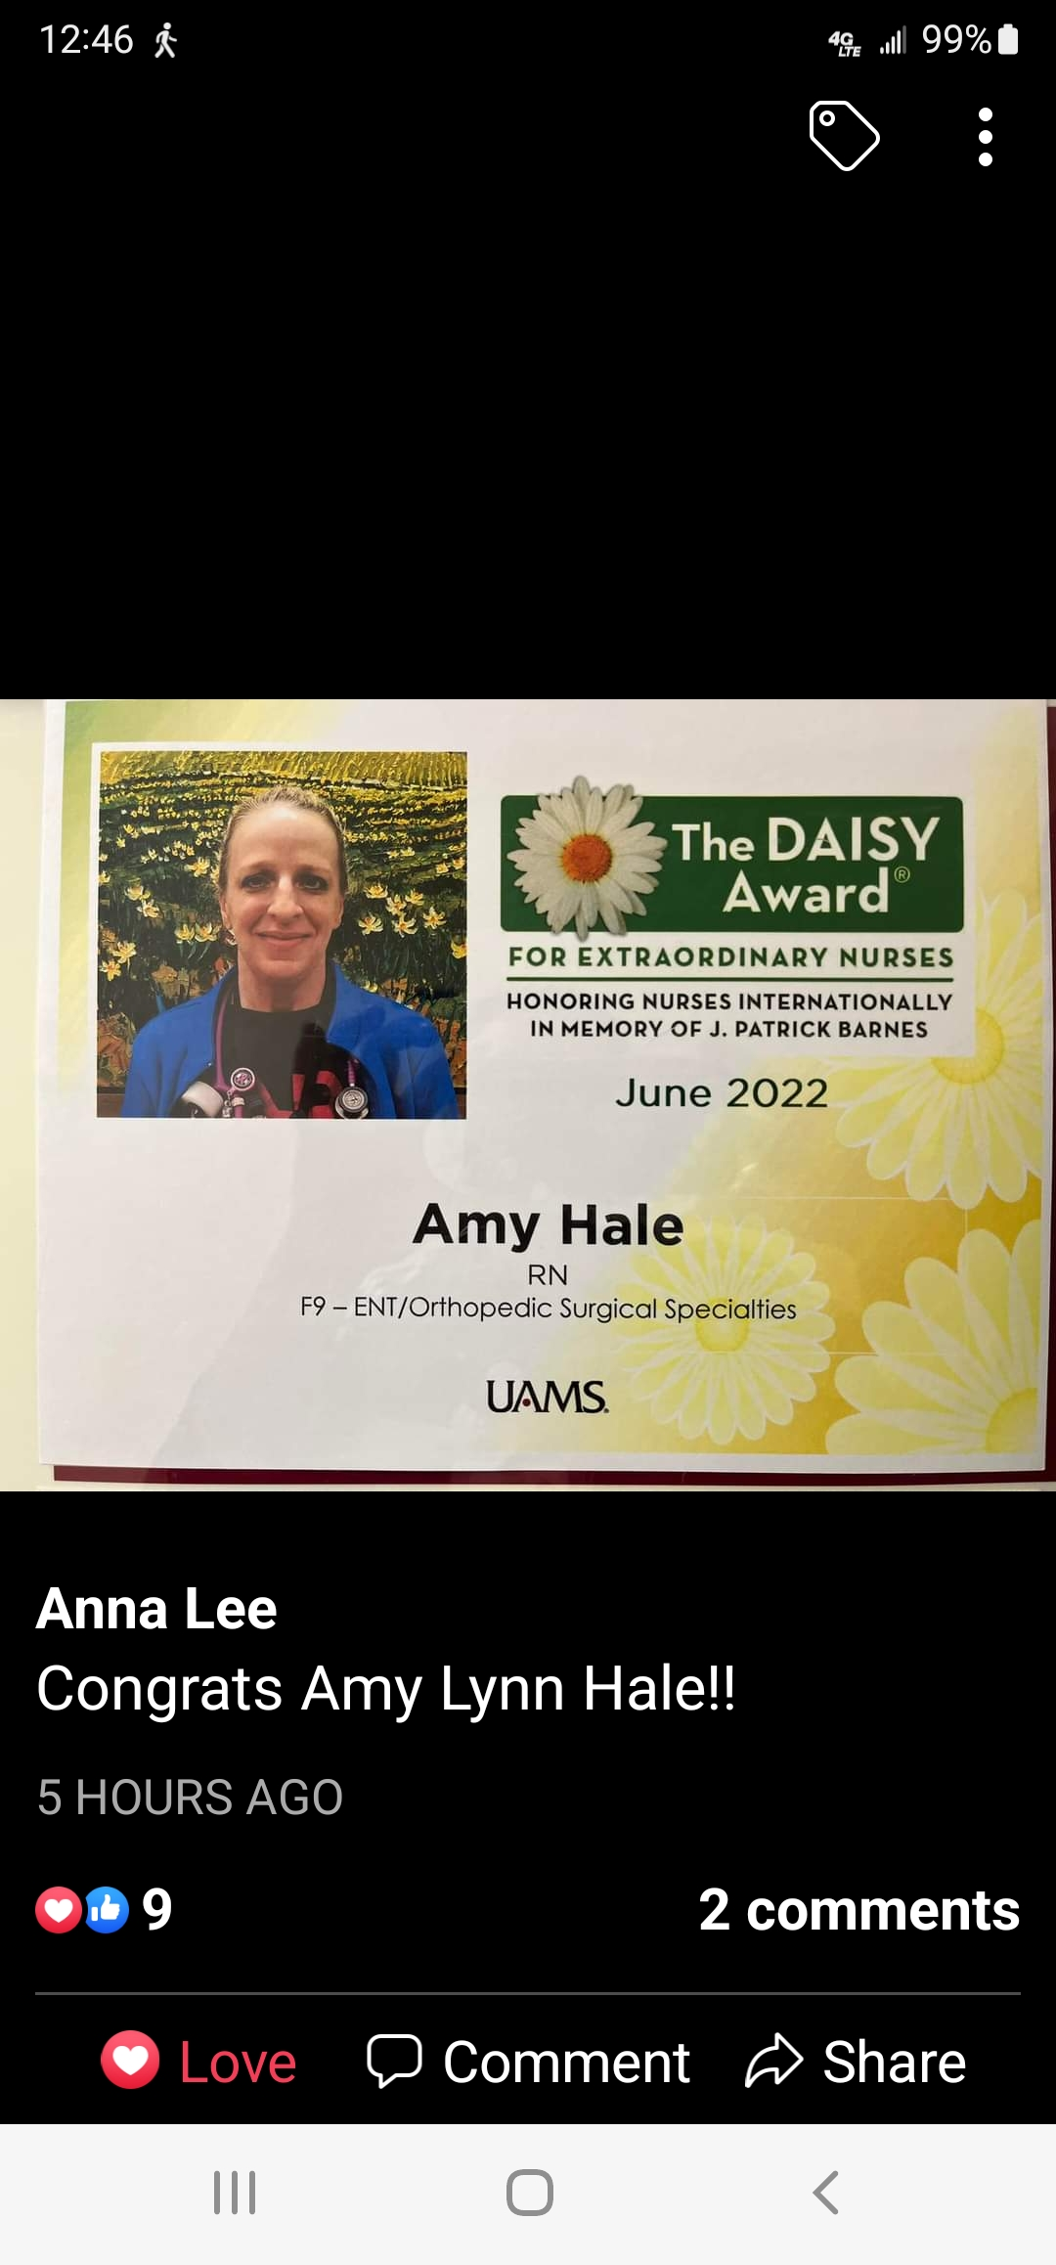
Aiming to provide the same compassionate care that I received from my medical team

Slide 12
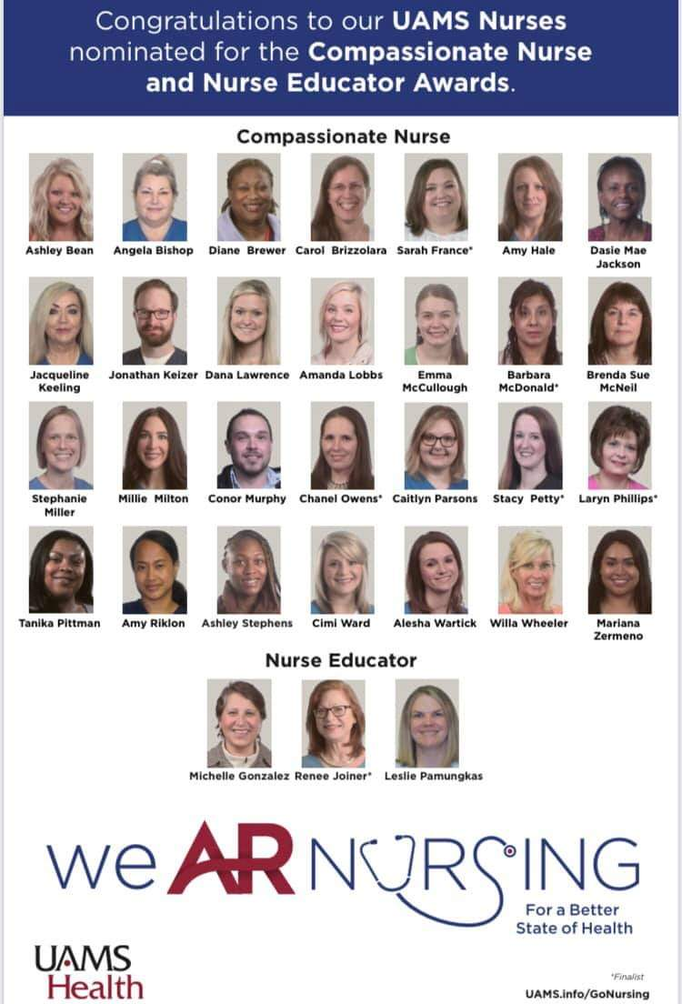
Compassionate Nurse Award Nomination

Slide 13
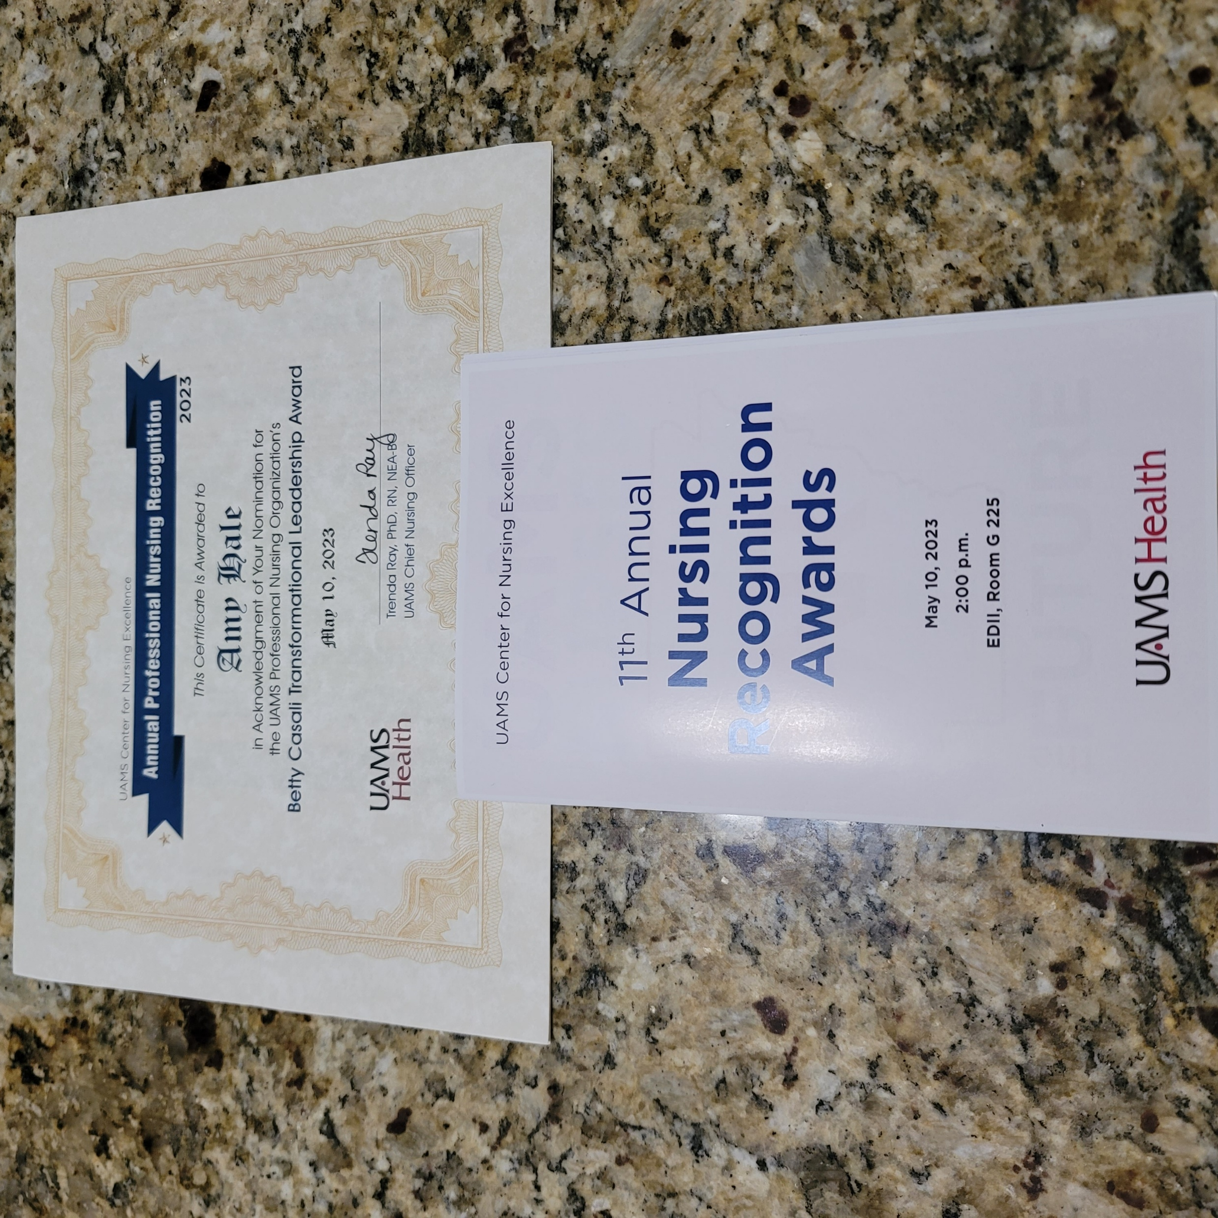
Transformational Leadership Award Nomination

Slide 14
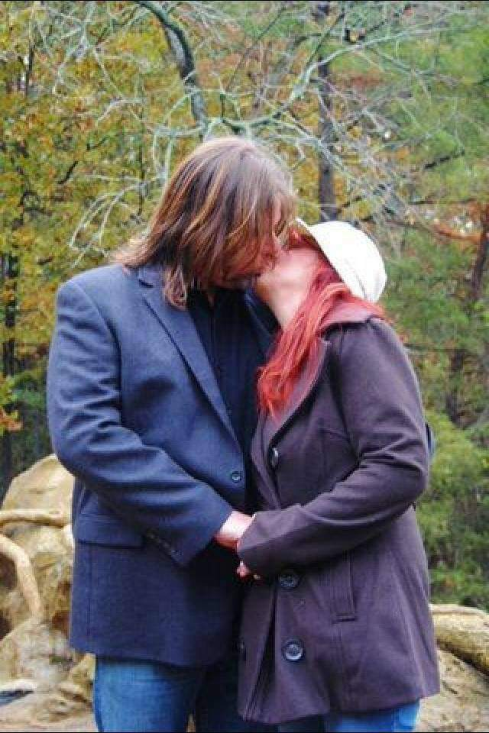
Learning to Trust & Love Again

Slide 15

True Love Doesn’t Hurt

Slide 16

Rebuilding A Family Together

