Slide 1

Notes:
Thank you for inviting me here to tell my story… I promise to protect the innocent..and give you a few laughs.

Slide 2
UAMS Disclosure Policy
It is the policy of the University of Arkansas for Medical Sciences (UAMS) to ensure balance, independence, objectivity, and scientific rigor in all directly or jointly provided educational activities.
All individuals who are in a position to control the content of the educational activity (course/activity directors, planning committee members, staff, teachers, or authors of CE) must disclose all relevant financial relationships they have with any commercial interest(s) as well as the nature of the relationship. The ACCME and ACPE describe relevant financial relationships as those in any amount occurring within the past 24 months that create a conflict of interest. Individuals who refuse to disclose will be disqualified from participation in the development, management, presentation, or evaluation of the CE activity.
Notes:
(Regina)
UAMS Disclosure Policy

Slide 3
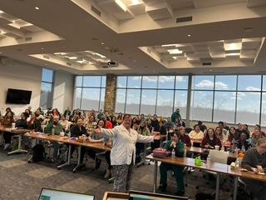
HOW DID I GET HERE?
GUEST SPEAKER AT THE 5TH ANNUAL afna CONFERENCE 2026
Notes:
So How did I get ask to speak today…Everyone else was busy or DEAD.
Sherri ask me to speak on my enthusiasm for this field of nursing and maybe give you new ones a few tips along the way.

Slide 4
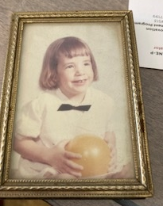
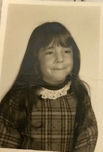
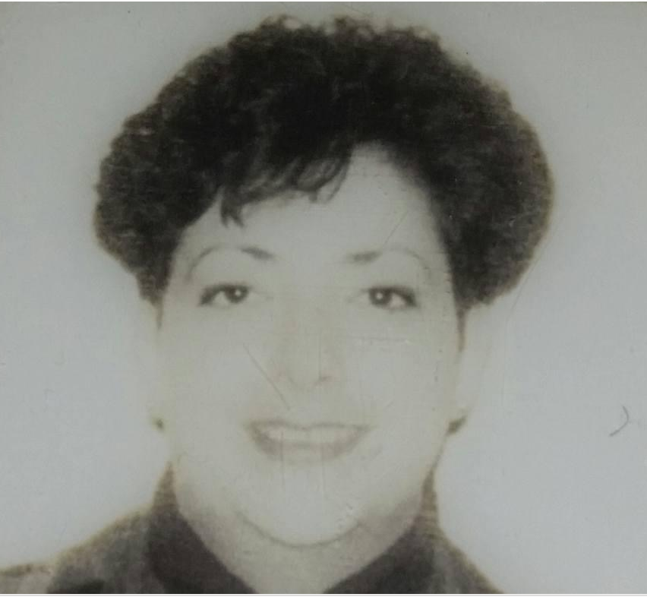
1986 Graduated from Millikin University with BSN ,Decatur Illinois
Started working as Labor/Delivery nurse
Joined the Airforce 1989-1995
1995-1997 NICU nurse
1997-2001 ENT clinic nurse
2001-2019 Willow Creek Womens Hospital L/D triage
2008-2024 SANE
2019-present UAMS
Notes:
I dont have any pictures pre-cellphone area, and these 3 are pictures of pictures that i had. Just a brief history of my Nursing career…Vagina’s and more Vagina’s, few bloody noses along the way.

Slide 5
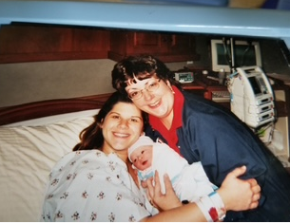
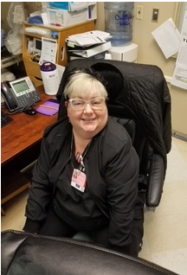
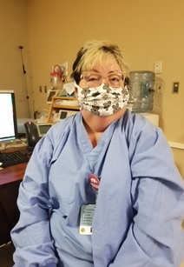
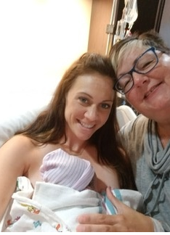
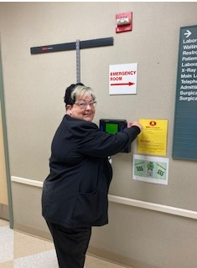

Willow Creek Women’s Hospital
Notes:
These are pictures of my patients that i delivered. I worked at WCWH for 19 years.
While attending a gymnastic class for my daughter in 2008 I noticed another mother grading papers in the stands. We spoke and she was a nursing instructor at UAFS for OB. I told her i was a L/D at Willow. She asked if I had ever heard of SANE nursing. She was involved that and I said no. So she explained a little about and thought how interesting.
The very next morning i pulled out a nursing CEU flier with Diana Faugno on it speaking about Forensics nursing. So I signed up and went to it. What a great presentation. So knowledge so down to earth. This is when CSI first came out and was very glamorous..lol
So i contacted the lady from UAFS and she sent me to study with Kathy Bell in Tulsa. It was a week long class so much information A couple months later I went back and did the Pediatric Sane training with her as well..

Slide 6
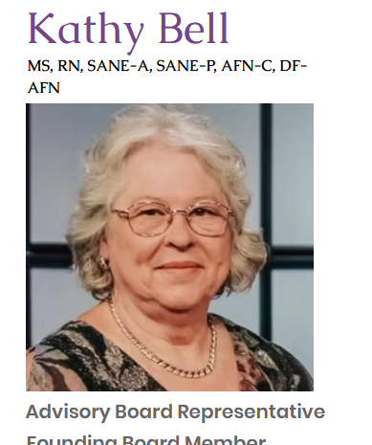
Joined the Tulsa Police Department in 1994 and retired in 2022. She provided the day to day operations management of the forensic nurse examiner program. She was responsible for training programs that facilitated other communities in providing forensic nurse examiner services.

Slide 7
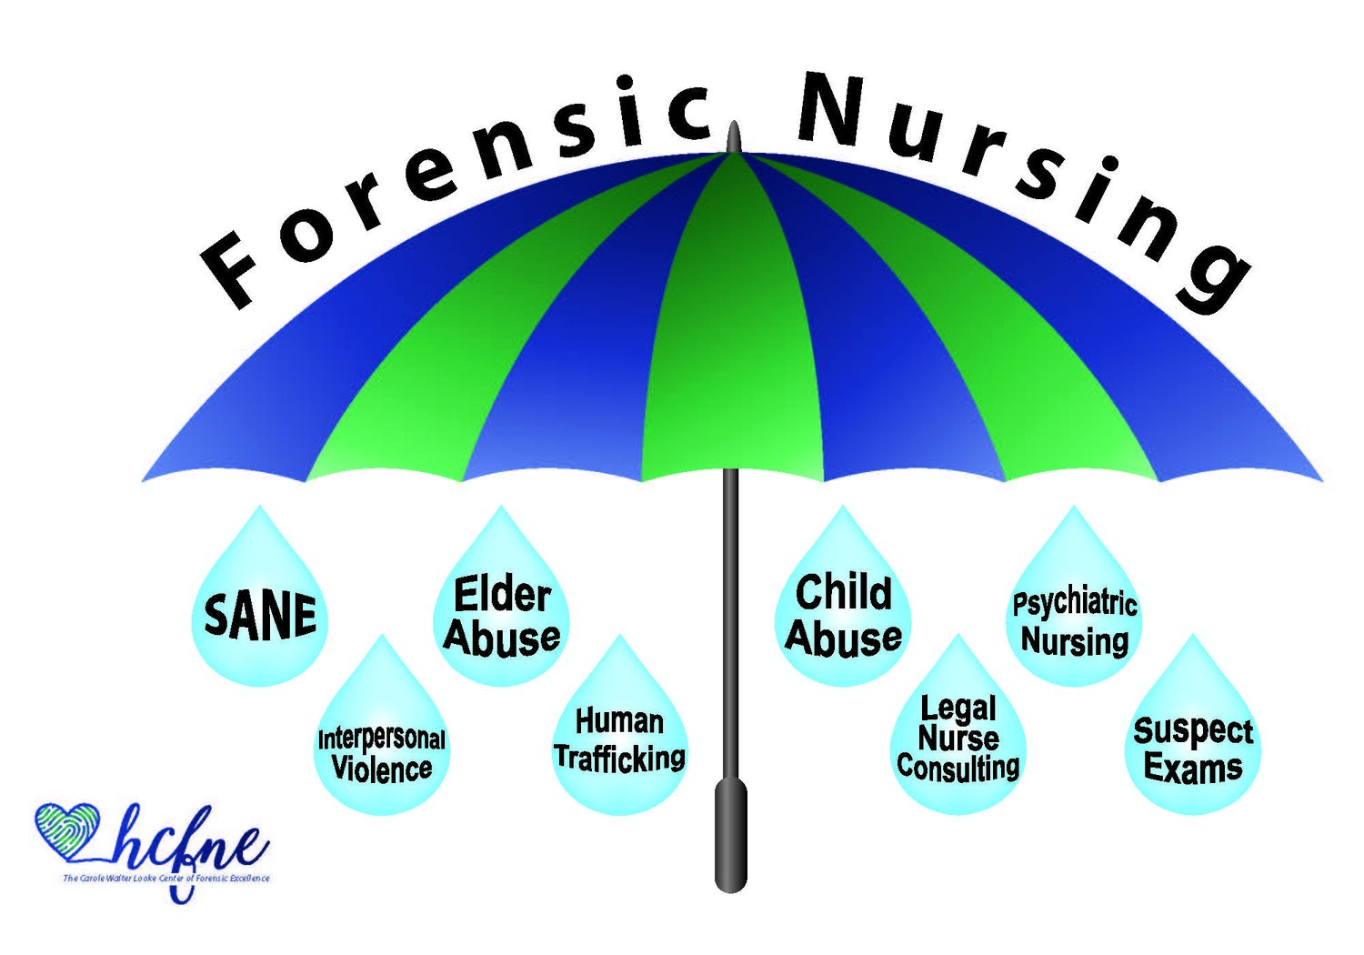
Notes:
Remember FN encompasses many paths, there are really no limits to what you can do today with this umbrella. I chose the SANE adult and Sane peds to develve in

Slide 8
History of Forensic Nursing
16th Century: forensic medicine focused on cause of death
18th Century: midwives testified in court on matters like (gulp) virginity, pregnancy, and rape.
1992: First certification of Sexual Assault Nurse Examiners (SANE), and a new field was born.
The “mother” of forensic nursing: Virginia Lynch is recognized.
• An emergency room nurse
• Visited a crime lab in 1982
• Became obsessed with forensics

Slide 9
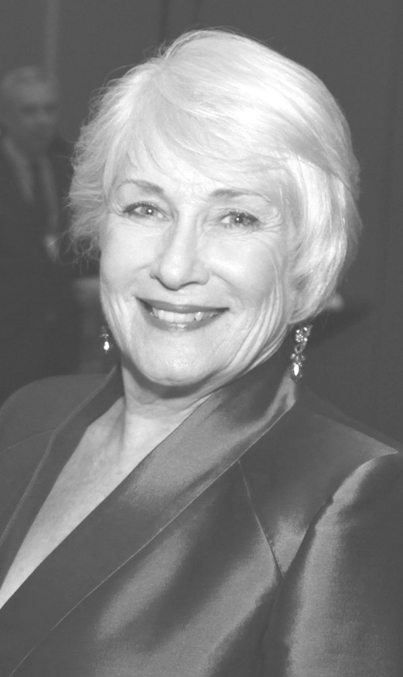
Virginia Lynch
"Clinical Forensic Nursing: A Descriptive Study in Role Development"
Visionary
Pioneer
Researcher
Educator
Notes:
Virginia Lynch is regarded as the founder and pioneer of Forensic Nursing and founded the IAFN (International Association of Forensic Nursing) 1992.
She started her forensics career as a medicolegal death investigator in Fort Worth, Texas in 1984
Her interest is forensics started on a visit to a crime lab in Texas in 1982. the need for this new area of nursing expertise arose out of her learning how evidence such as clothing, specimens and personal documents were of the lost or discarded instead of being properly handed over to the authorities.
"When I asked the police if the person who abused, raped or killed these patients would be caught and punished, they told me it was unlikely because the doctors and nurses lost and destroyed the evidence," she said. "It had never occurred to me that the healthcare professions were unintentionally obstructing justice." -Virginia A Lynch, MSN, RN, FAAFS, FAAN
The Telesane team all got to meet her at a conference in Dallas. So much
fun to meet one of the “Elite”

Slide 10
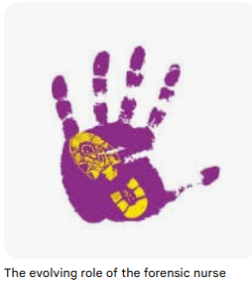


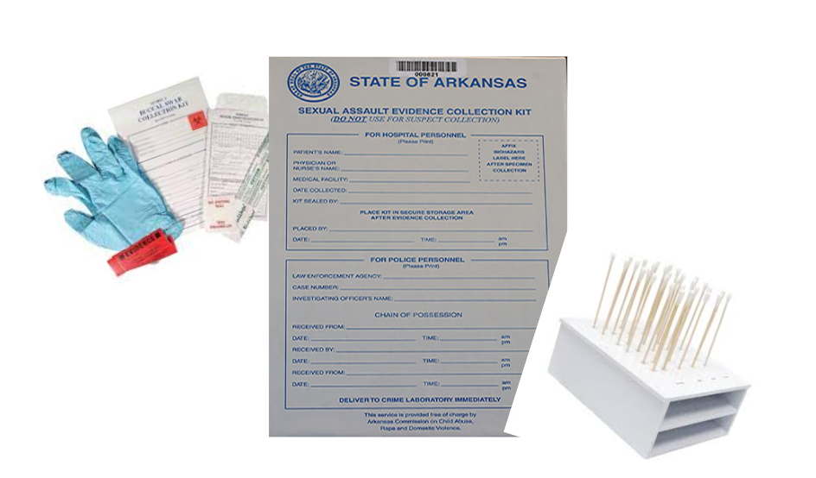
Notes:
So i worked with a group of nurses in Fort smith performing sexual assault exams on my own. I remember being terrified and scared all the time…am I doing this correctly? Am I helping the victim? What if I make a mistake? I also worked with some great advocates that were at the bedside with the victims (clients) all the way. I mean I got to spend 2-4 hours with the patient and never saw them again unless it was in court. But the advocates walked besides them the whole way.
Then there was the relationship with Law enforcement.. Not much.. They picked up the kits or evidenced bag..ask a few questions ..usually “did it really happen” did u see any trauma etc… always felt like I had to defend my client..that th
There wasn't going to be an investigation unless I said yes it happened..
Had a couple of management changes and never really felt support from my immediate supervisor no real feed back and if I ask questions about a case i got “why don’t you know this?” so didnt really feel support.
Personal life went to hell, husband divorced me and met someone new. I was left with 2 young teenagers at home that were heart broken and I worked a lot to pay bills and didnt feel like i could get up in the middle of the night to do cases and leave them by their selves. Started developing anxiety before cases etc etc.. so I resigned.. And i remember leaving and the advocates i worked with where heart broken but my supervisor took my letter of resignation like i told her i was changing my underwear. No Big deal..
I was free…but felt like a loser…
Continued to Work at Willow, became lead ER Triage nurse and loved my job and the physicians and nurse loved me and patients.
I still had the SANE knowledge but it was in the back ground….. For a while…
I pulled it out on occasion….speak about lady with GI abd pain frequent flier etc….

Slide 11
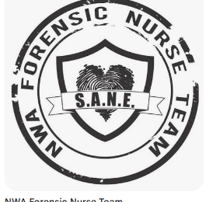

How did I get started? AGAIN

Slide 12
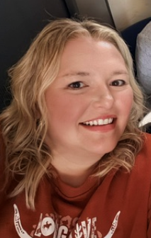
I met Sherrie Searcy at a Hospital Conference about hospital’s response to Sexual assault. And she got me interested again…
Notes:
I developed Willow Creek’s responce to Sexuall assault
Did quarterly training with all the nurses and physicians
Develop SAFE cart
Instituted the Kit tracking and logging
Talk about the “possible “ traffic person
Speak on taking time to see the patient just not staring at the computer asking the same safety questions over and over.

Slide 13
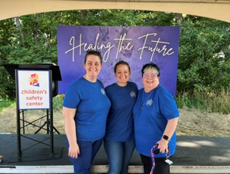
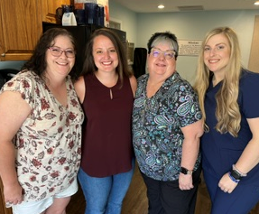
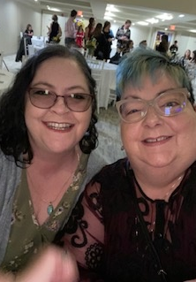
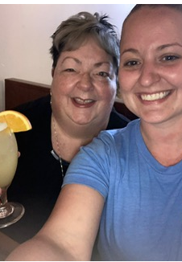
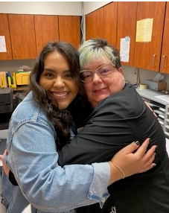
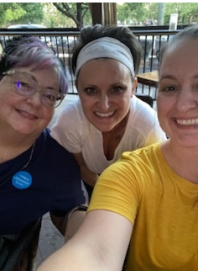
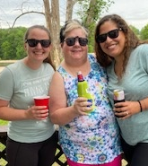

Slide 14
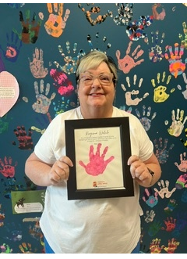
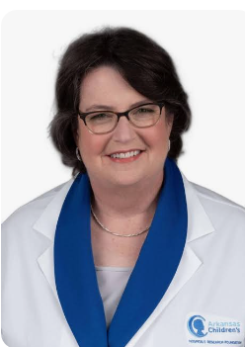

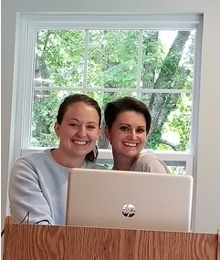
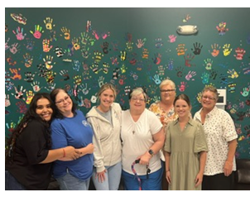

Notes:
Speak about my time with NWA

Slide 15
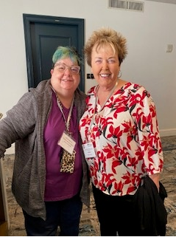
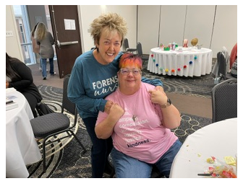

How did I get into the
SANE world
Diana Faugno
MSN,RN,CPNSANE-A/P,FAAFA,DF-IAFN
Notes:
.

Slide 16
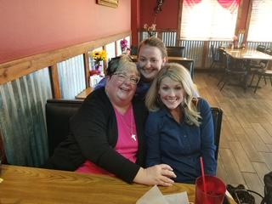
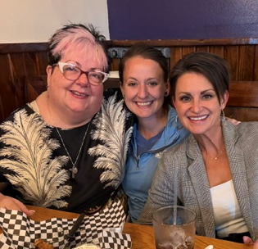
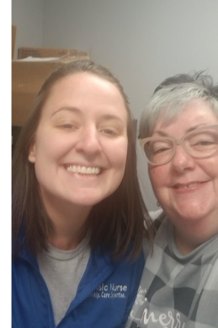
How did I get started ???

Slide 17


Slide 18
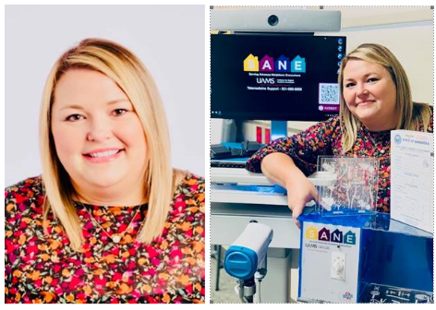
She changed my life meeting her at the Sexual Assault Hospital Protocol Conference in 2015….

Slide 19

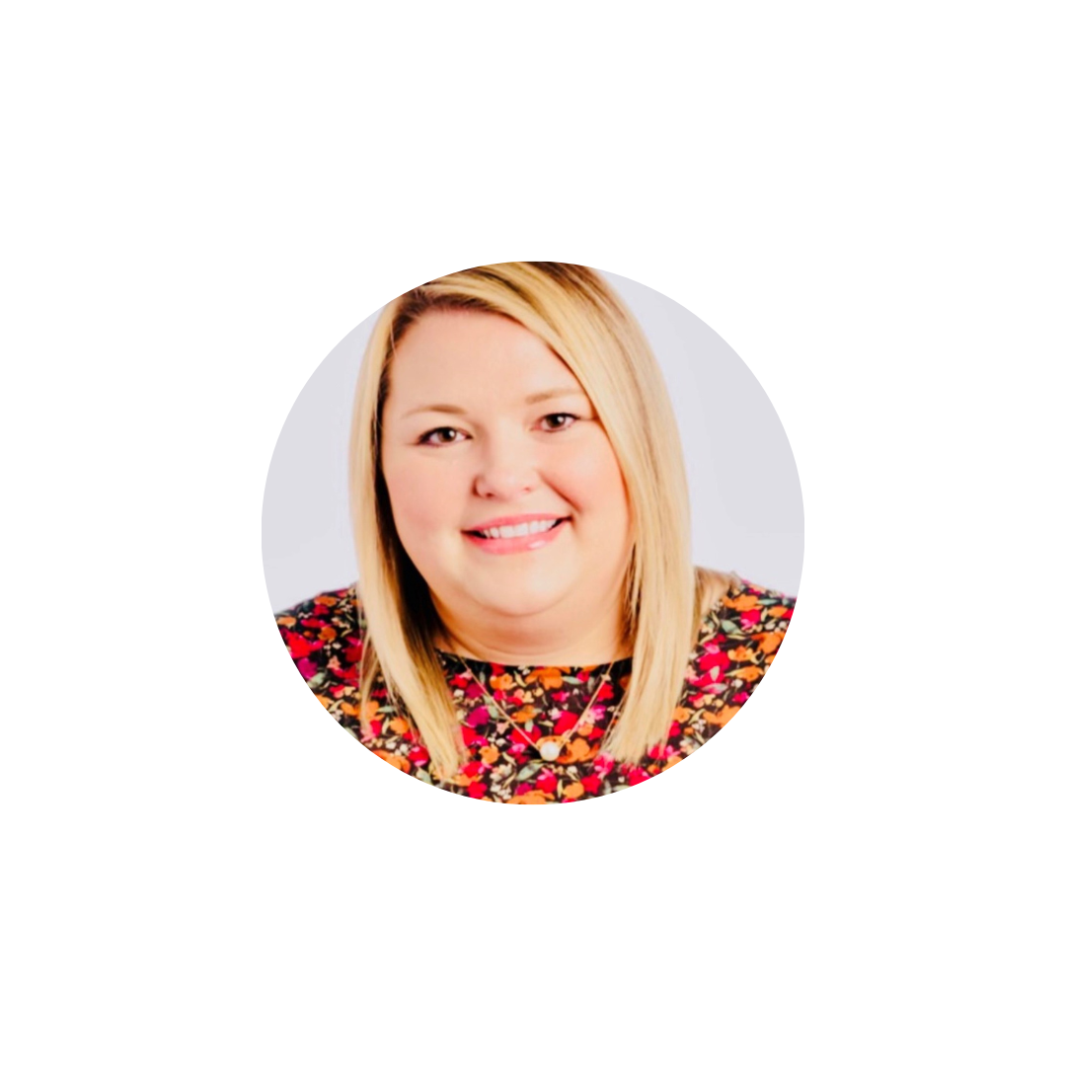
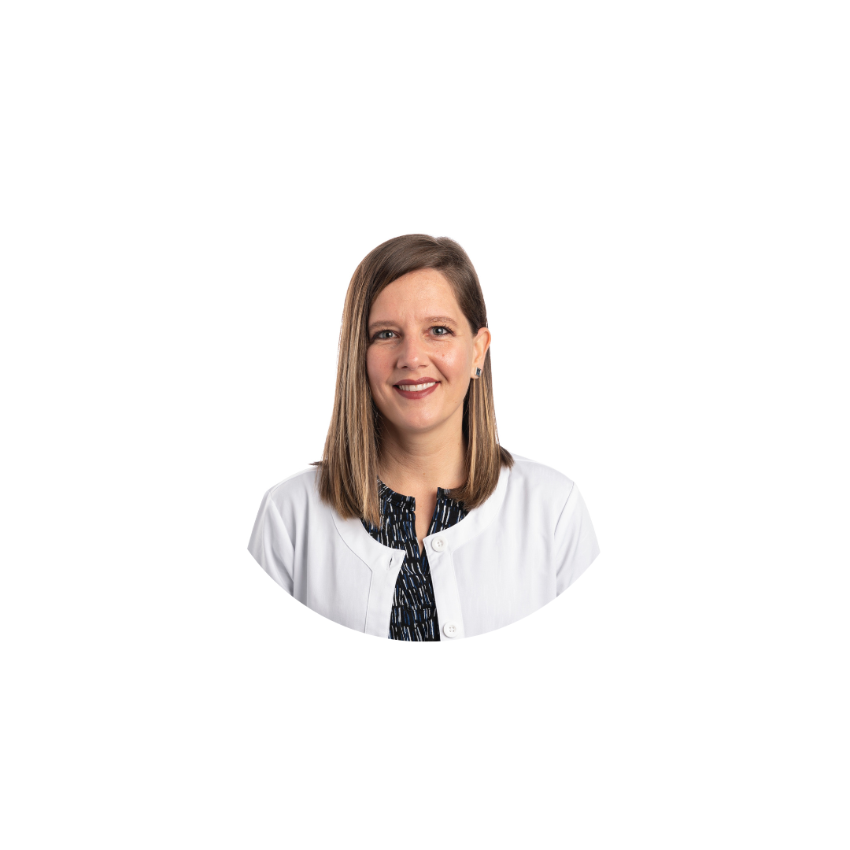
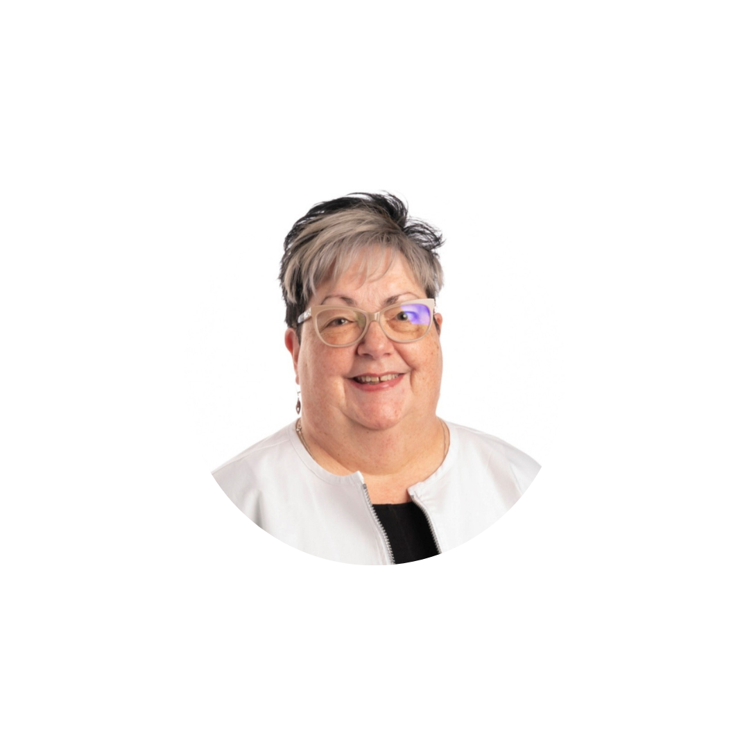
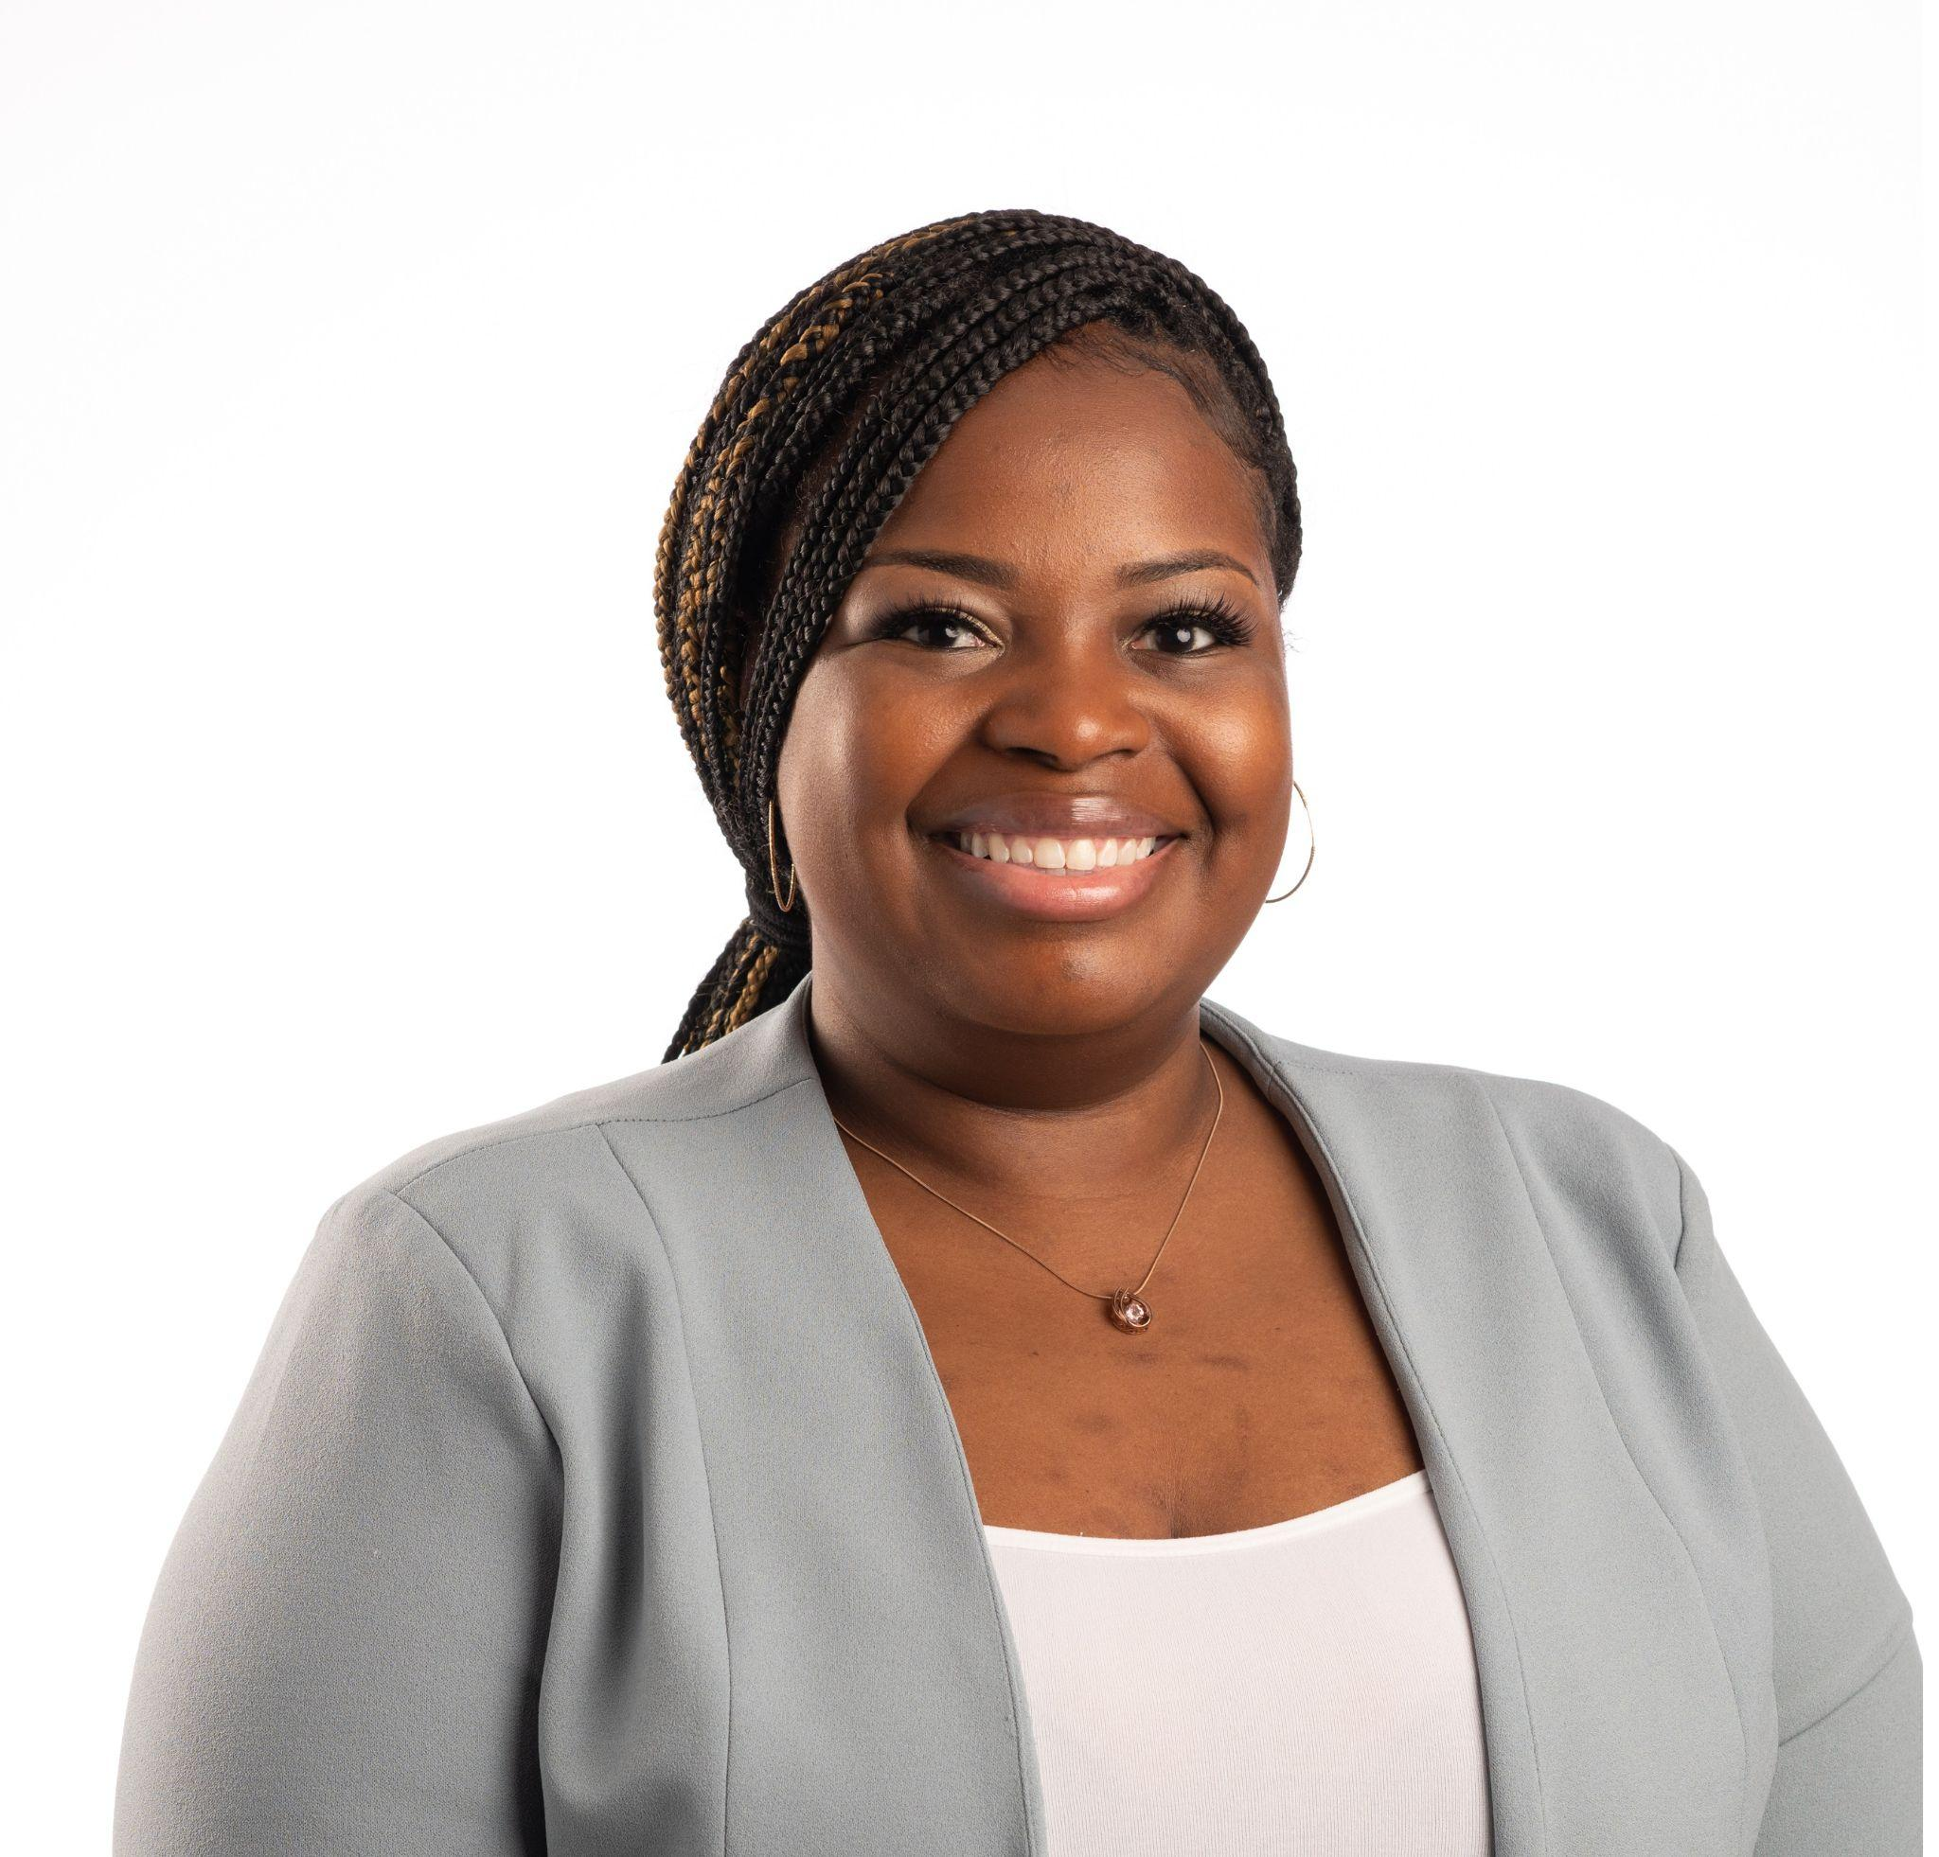
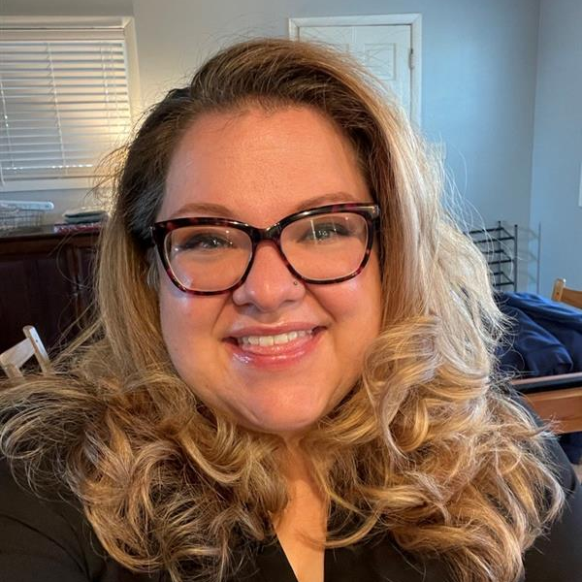
What are SANEs?
Sexual Assault Nurse Examiners (SANE) are registered nurses who have completed specialized education and clinical preparation in the medical forensic care of the patient who has experienced sexual assault or abuse.

Slide 20
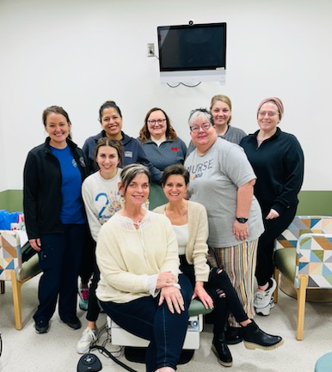
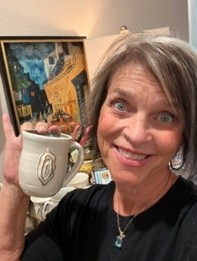
Golden Vagina

Slide 21

FIND YOUR PASSION:
ENTHUSIASM: great excitement & active interest in something
ZEAL: great energy or enthusiasm for a cause or objective
FERVOR; intense & passionate feeling

Slide 22


Slide 23




Rock the Doc
With Regina!

Slide 24
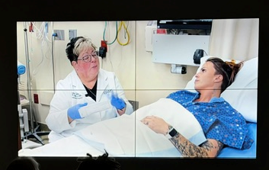
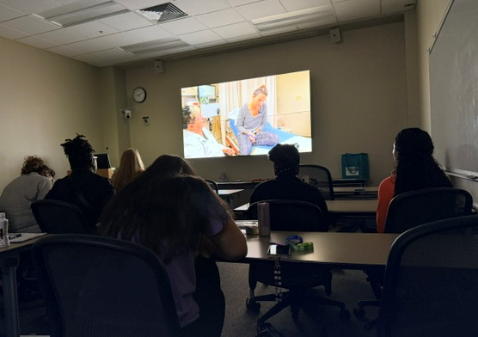

Slide 25
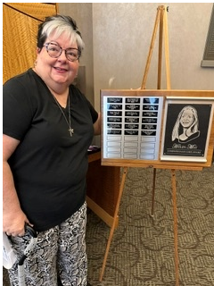

Slide 26
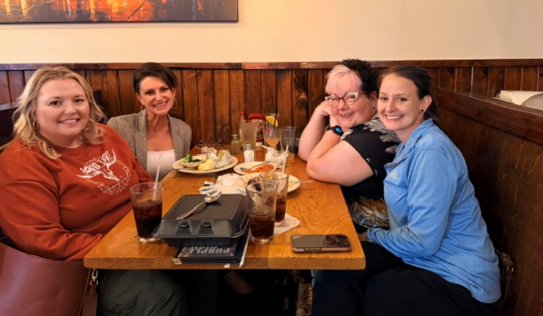
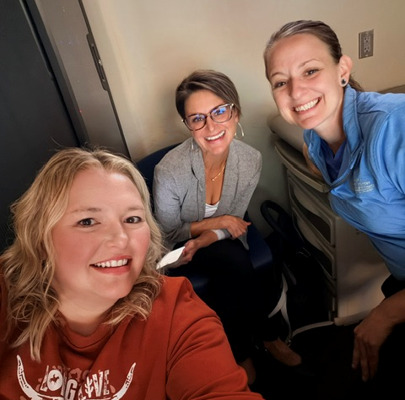

Slide 27
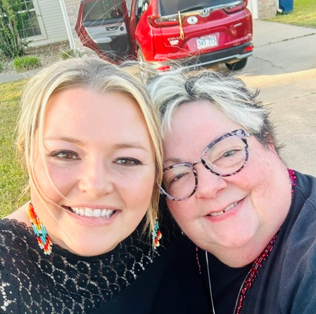
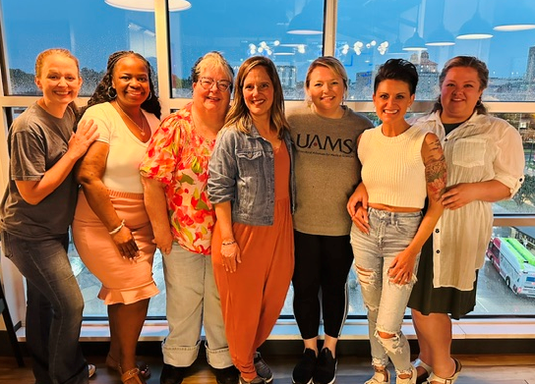

Slide 28
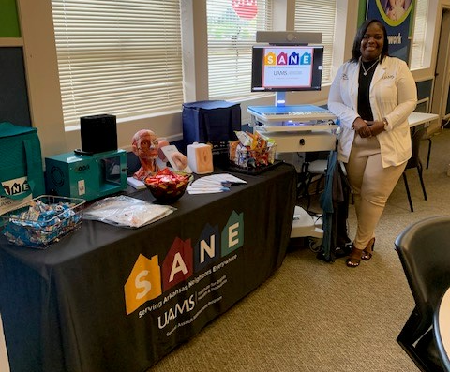
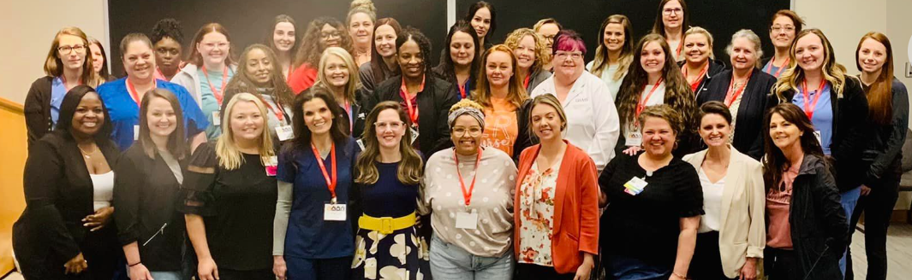
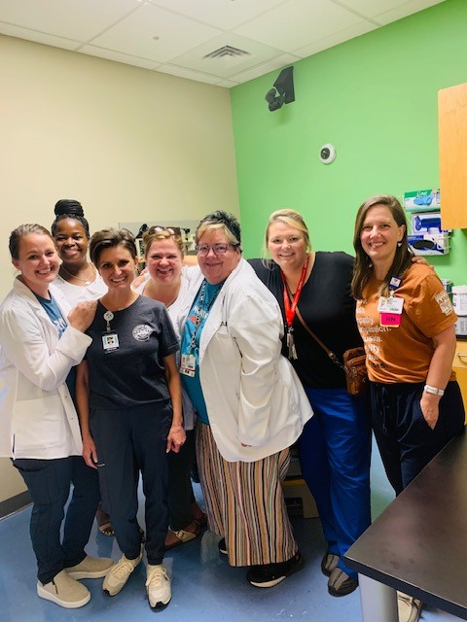


Increase patient access to specialty services!
Develop, train, and empower more Sexual Assault Nurse Examiners in every Arkansas community.
Notes:
Reference volume of SANE-As in Arkansas

Slide 29



Slide 30

He is OFF the MARKET!!

